Slide 1

Applying the
Azure Well-Architected Framework
to
Azure Synapse Analytics

Slide 2
The Microsoft Azure Well-Architected Framework is a set of 5 pillars which can be used to help an organisation improve the quality of their Azure workloads and infrastructure.
1
3
5
Cost Optimisation
Performance Efficiency
Security
2
4
Operational Excellence
Reliability
We can apply settings and features from the Dedicated SQL Pools and Serverless SQL Pools to these pillars.

Slide 3
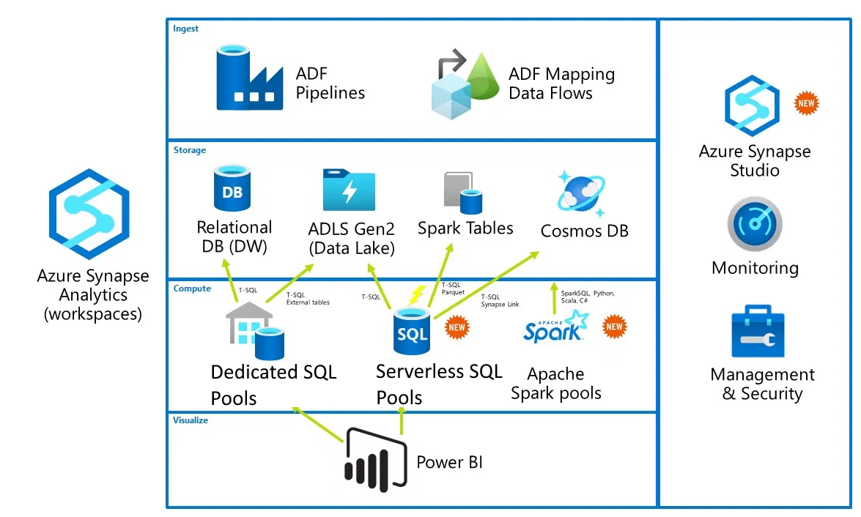
Synapse Analytics Components
Synapse is a set of services that have been brought together into a unified platform.
Dedicated SQL Pools
Serverless SQL Pools
Spark Pools
Pipelines (Data Factory)
Data Explorer Pools
Power BI integration

Slide 4
Who is the Framework for?
The framework is just as relevant to a large multi-national organisations infrastructure as to a Small/Medium Sized business, and a single person with their own infrastructure.
Who really likes:
Spending too much money
Spending time administrating your infrastructure (unless that is your role!)
Spending time watching………….
things………….
progress
Deployments and code breaking (unless intentionally!)
Data being stolen
There is cross-over in terms of features and pillars.
E.G. a feature that helps with cost optimisation can also help with Performance Efficiency

Slide 5
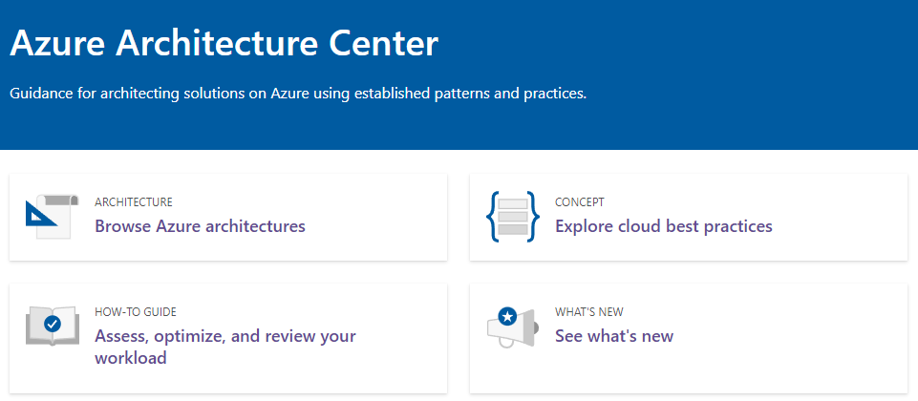
Azure Architecture Centre
The Azure Architecture Centre is part of the overall Microsoft Documentation resource online.
Within the Architecture Centre are areas which look at:
Reference Architectures
Well-Architected Framework
Best Practices
https://docs.microsoft.com/en-us/azure/architecture/

Slide 6
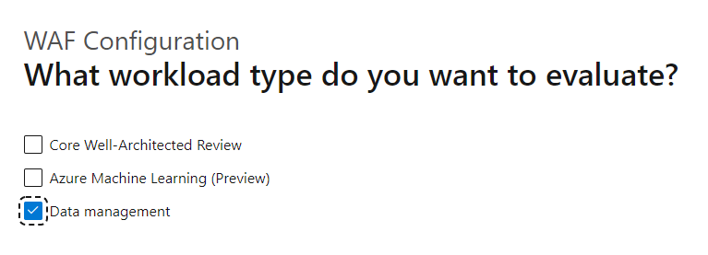
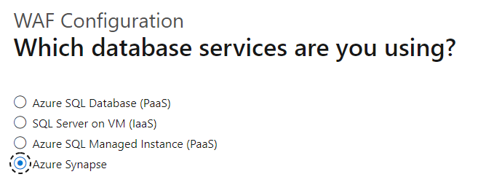
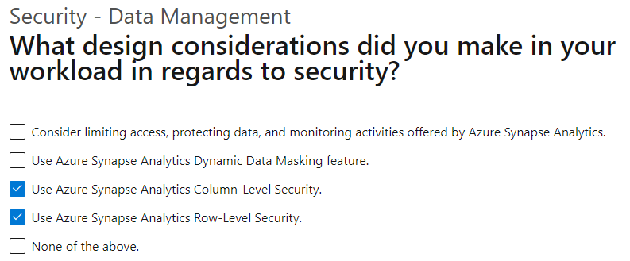
Assessment
Within the Azure Architecture Centre is an Assessment process which is a series of questions across the 5 pillars.
You can choose which pillars to assess.
For each question you are given a series of checkboxes.
Pillar | Number of Questions
Reliability | 12
Security | 7
Cost Optimisation | 6
Operational Excellence | 6
Performance Efficiency | 6

Slide 7
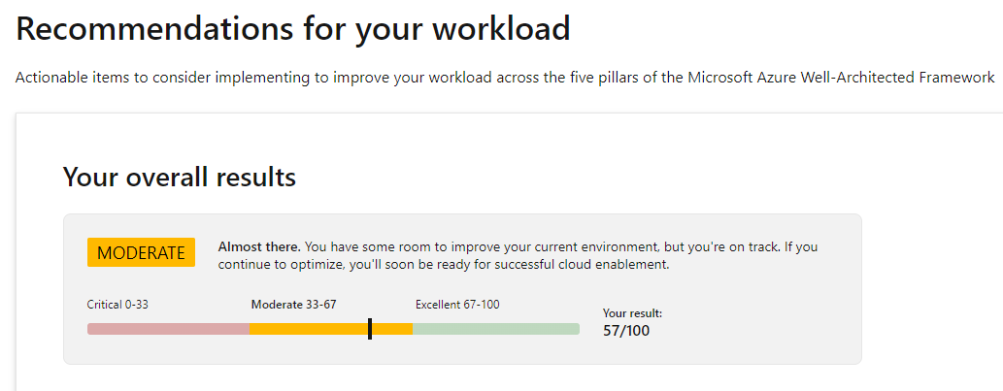
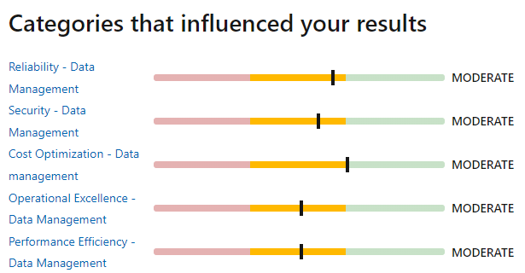
Assessment Score
Once the assessment is complete you are given an overall score.
Depending on which pillars (categories) were selected at the beginning of the assessment will dictate the influence on the overall score.
You are able to re-take the assessment at any time once you have addressed an area.

Slide 8
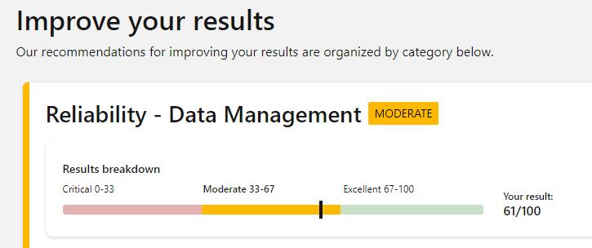
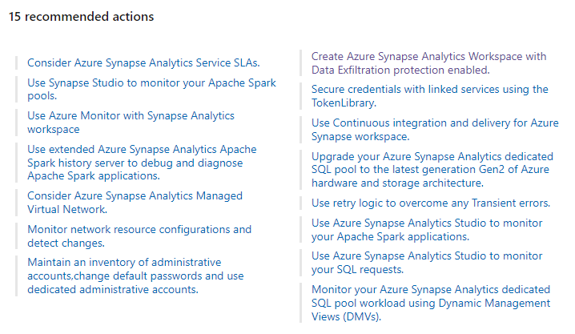
Assessment Breakdown & Resources
To address any concerns across the pillars (categories) each pillar provides a set of resources to review.
For each pillar there are recommended actions to take.

Slide 9
1
Cost Optimisation
In terms of optimising costs we are looking to maximize the value delivered whilst keeping costs as low as possible.
Dedicated SQL Pools
Serverless SQL Pools
Assign compute using DWUs from DWU100 (60GB) to 30000 (18TB) to suit workload. Potentially use a higher DWU to load data then lower the DWU to query data during the day.
The cost is based on Data Processed on-demand which includes both Reading data from and Writing data to external storage.
Scale Up and Down, and also Pause using Azure Automation, Functions, Pipelines.
Recommended practice is to optimise Data Types and where possible use Parquet.
1 & 3 Year Reserve Pricing per DWU100 can reduce pricing by up to 65%.
Data Processed can be seen in Synapse Studio and also in system views
Amount of Data Processed
Daily, Weekly, and Monthly Limits set
Azure Pricing Calculator includes Dedicated SQL Pools, Serverless SQL Pools, Pipelines, and Spark.

Slide 10
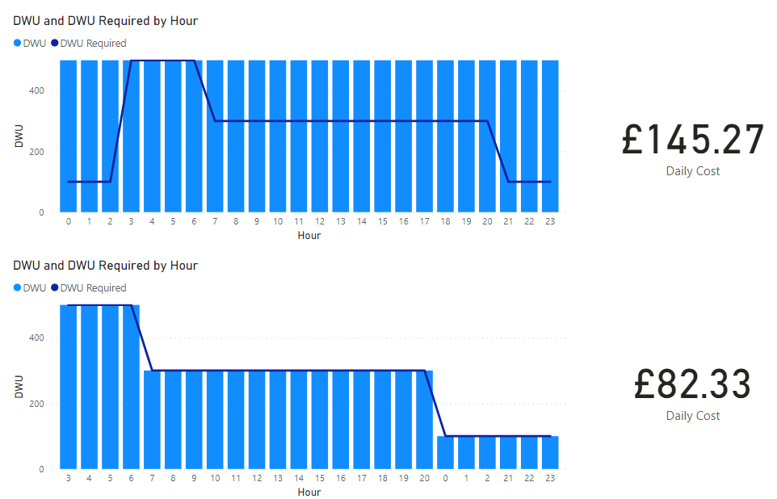
Dedicated SQL Pools DWUs Per Hour
If we set the DWU size to a value and never change it then it may not be optimised for cost.
If analyse our expected workload and match the DWU accordingly then we can optimise our costs.

Slide 11
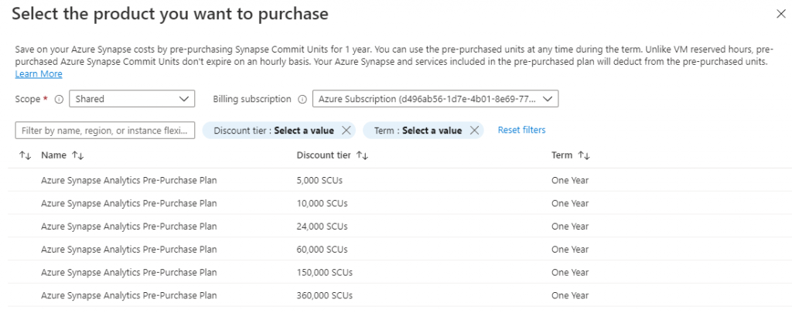
Pre-Purchase Synapse Commit Units
Microsoft now offer a pre-purchase plan called SCUs (Synapse Commit Units). The units can be used across services within the Synapse eco-system:
Azure Synapse Analytics Dedicated SQL Pool
Azure Synapse Analytics Managed VNET
Azure Synapse Analytics Pipelines
Azure Synapse Analytics Serverless SQL Pool
Azure Synapse Analytics Serverless Apache Spark Pool - Memory Optimized
Azure Synapse Analytics Data Flows
Savings start ~11%

Slide 12
2
Operational Excellence
Ensuring that we have operational processes that keep a system updated and running in production.
Dedicated SQL Pools
Serverless SQL Pools
Database projects are supported and can be created using SSDT in Visual Studio and Azure Data Studio. A full CI/CD process can then be created using Azure DevOps integration to deploy code changes.
The is currently no SSDT support, however SQL Scripts to create objects can be source controlled using Synapse Studio Source Control integration.
Enable logging using Azure Log Analytics.
System Views to track Data Processed volumes by Day, Week, and Month. If limits have been set, monitoring data processed usage is vital.
Use Azure Monitor to surface alerts and metrics to monitor DWU usage, Cache usage, RAM utilisation, and CPU usage.
Azure Monitor can also surface metrics to monitor data processed volumes, plus login attempts, and ended SQL requests.

Slide 13
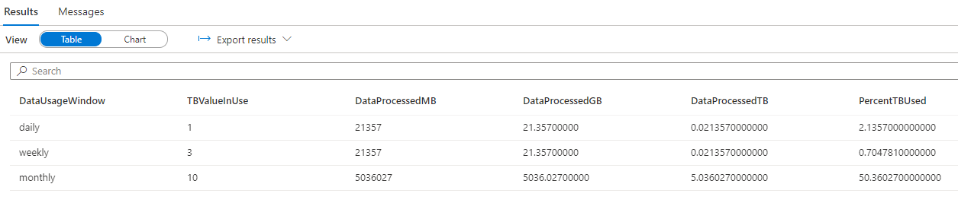

Monitoring Data Processed
An example of monitoring data processed and Daily, Weekly, Monthly limits set:
In this example, we have currently used 50% of the capped 10TB limit
Changing the monthly cap to 4TB now means no more queries can be executed…

Slide 14
3
Performance Efficiency
The ability of a system to adapt to changes in load and ensure performant operations such as data loading and delivery.
Dedicated SQL Pools
Serverless SQL Pools
Currently auto-scaling DWUs “online” is not supported so resizing compute is an offline process.
With the Polaris engine there is no need to set any workload settings or classification as the service will scale and allocate resources during workload execution.
The Workload Classification, Importance, and Isolation feature allows certain workload sizes to be allocated the required resources.
Consider using Serverless SQL Pools to query data external to the Synapse ecosystem rather than loading/transforming to another data store.
Classify Incoming Workload
Assess Importance
Isolate Resources
There are a set of best practices which include data type optimisation, storage co-location, and using partition pruning functions such as filepath & filename.
There are a set of best practices which include data loading strategies, table distribution & partitioning strategies.

Slide 15
4
Reliability
The ability of a system to recover from failures and return to operation.
Dedicated SQL Pools
Serverless SQL Pools
When the Dedicated SQL Pool is running, Automatic Restore Points are created periodically during the day and are available for 7 days. You can also create User-Defined Restore Points if you regularly scale/pause the service (limited to 7 Days retention).
Automatic Fault tolerance in Polaris engine with an automated query restart process. “Tasks” will be restarted automatically in the event of a failure and this is a seamless process to the user/query executor.
You can enable/disable Geo-Backup which will backup to a paired region, E.G. UK South and UK West.
Consider co-locating Storage Account within the same region as Synapse Analytics.
Enabling Threat Protection to detect anomalous activities which impact security but also workload operations.
Consider using Managed Virtual Network & Private Endpoints to control and isolate traffic.

Slide 16
5
Security
Protecting applications and data from threats and malicious activity from any direction.
Dedicated SQL Pools
Serverless SQL Pools
Use Azure Active Directory Groups and Users, MFA, to secure access to databases, database objects and data.
As with Dedicated SQL Pools we can use Azure Active Directory Groups and Users to secure database objects such as Views and External Tables.
Enable Transparent Data Encryption (TDE) to encrypt data at rest and use your own keys.
Access to the data itself is based on Azure Storage permissions:
AAD Group/User
SAS credentials
Managed Identity
Database Key (CosmosDB)
Enable Microsoft Defender for SQL with periodic Vulnerability Assessment scans to determine current security state.
Managed Vnets, Firewall rules and Private Endpoints can be used to allow access to/from Synapse Analytics.
Dynamic Data Masking, Column-Level, and Row-Level Security are available.
Managed Vnets, Firewall rules and Private Endpoints can be used to allow access to/from Synapse Analytics.
Advanced Threat Protection for detecting and alerting malicious activity.

Slide 17
References
Document | Link
Microsoft Azure Well-Architected Framework | https://docs.microsoft.com/en-us/azure/architecture/framework/
Azure Well-Architected Review | https://docs.microsoft.com/en-us/assessments/?mode=pre-assessment
Azure Advisor | https://docs.microsoft.com/en-us/azure/advisor/
Azure Advisor Score | https://docs.microsoft.com/en-us/azure/advisor/azure-advisor-score

